Slide 1
GDP9 Raspberry Pi
Team Members:
Shreeprabha Aggarwal (sa10g10@soton.ac.uk)
Cathy Jin (cj8g10@soton.ac.uk)
Karishma Nune (kkn1g10@soton.ac.uk)
Carolina Ferreira (cf4g09@soton.ac.uk)
Supervisor:
Gary Wills (gbw)
Customers:
David Argles (da@ecs.soton.ac.uk)
Kate Bittles, IBM Hursley Executive Briefing Centre Manager
A Raspberry Pi Control Kit For Teaching

Slide 2
Introduction
Purpose: Purpose of the project is to develop an application that can encourage computational thinking and inspire the new generation to acquire more knowledge in practical computer science. This application can also be used by teachers to improve their Computer Science knowledge.
To achieve this we are using the Raspberry Pi and CECIL
Raspberry Pi: low-cost computing and interfacing device that has been specifically designed for learning about programming and hardware.
CECIL: Virtual lab environment designed for teaching the basics of how computers work.

Slide 3
Goals
Deliverables
CECIL - Virtual lab environment on Raspberry-Pi
Read and load from GPIO ports
User friendly interface - to facilitate teaching and learning of computer architecture and make it enjoyable.
Constraints
NO hardware or electronic implementations.
Methodologies
MVC
AGILE

Slide 4
CECIL Compiler

Slide 5
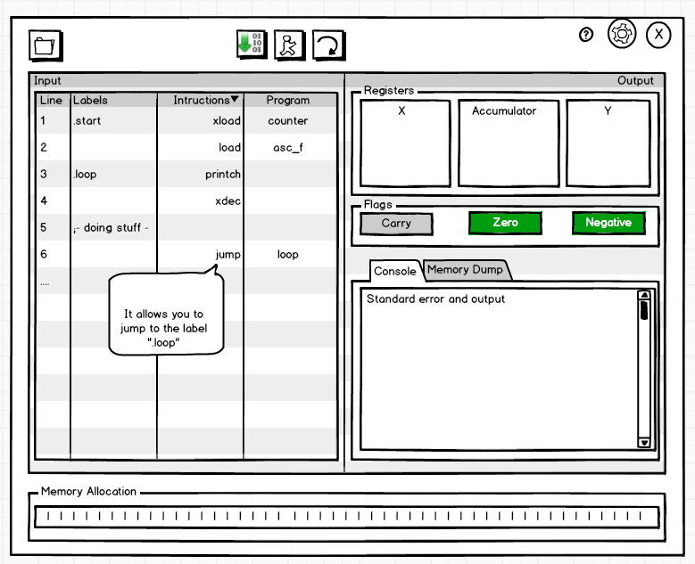
GUI Design
Designed with the aim of:
Promoting usability
Promoting accessibility
Being open to all ages
Notes:
GUI follows key usability principles e.g. constrained input, mapping buttons to actions via relevant icons, affordances - easy to see which parts are buttons and which are just views
Taking into account accessibility: Java Accessibility API for recommended font sizes etc, no colour specific functionality so that colour blind people can use it, predictive text for input

Slide 6
Project Management
Notes:
Gantt chart: each main development section subdivided into tasks which are shared so each group member is involved in all stages (MVC architecture means coding can similarly be broken down)
So far we’ve completed background research, requirements gathering, management and planning, have a solid design, and we’re starting implementation (on schedule). Writing report as we go
Next step is to verify the design with the client and get a working prototype done as soon as possible to show the client (estimated date?) and also potentially the target demographic (teachers)

Slide 7
Thank you for listening
Questions?

